Slide 1
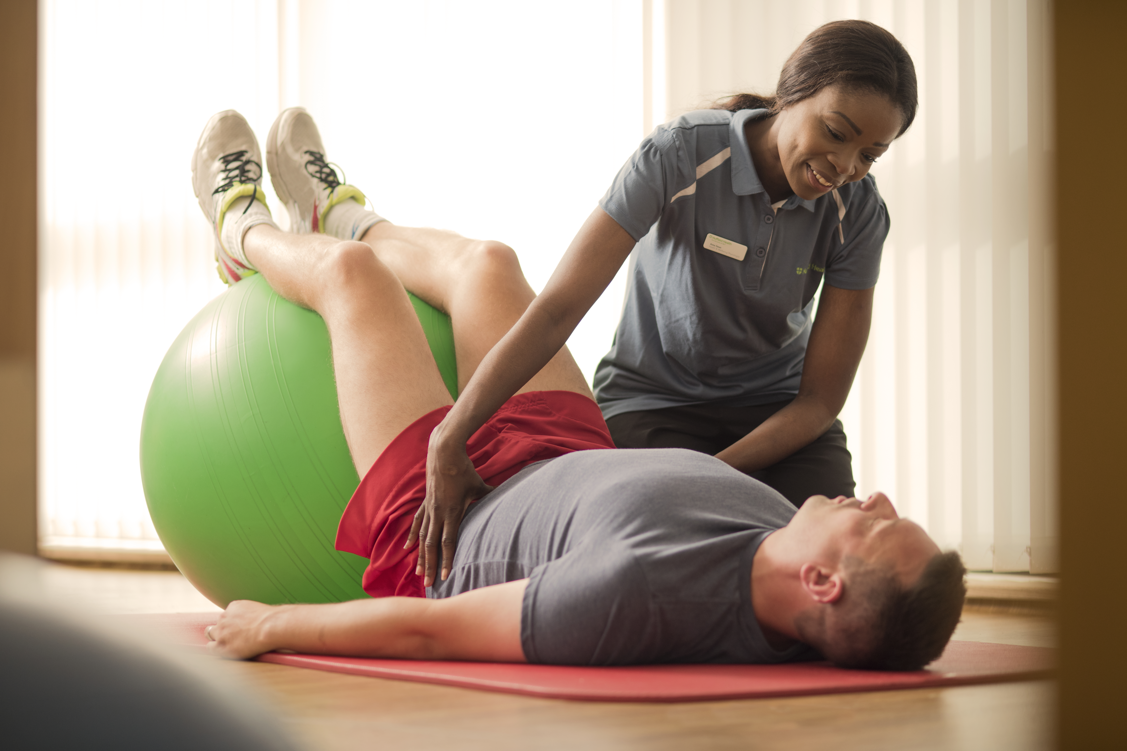
Search Engine Optimisation – Best Practice

Slide 2
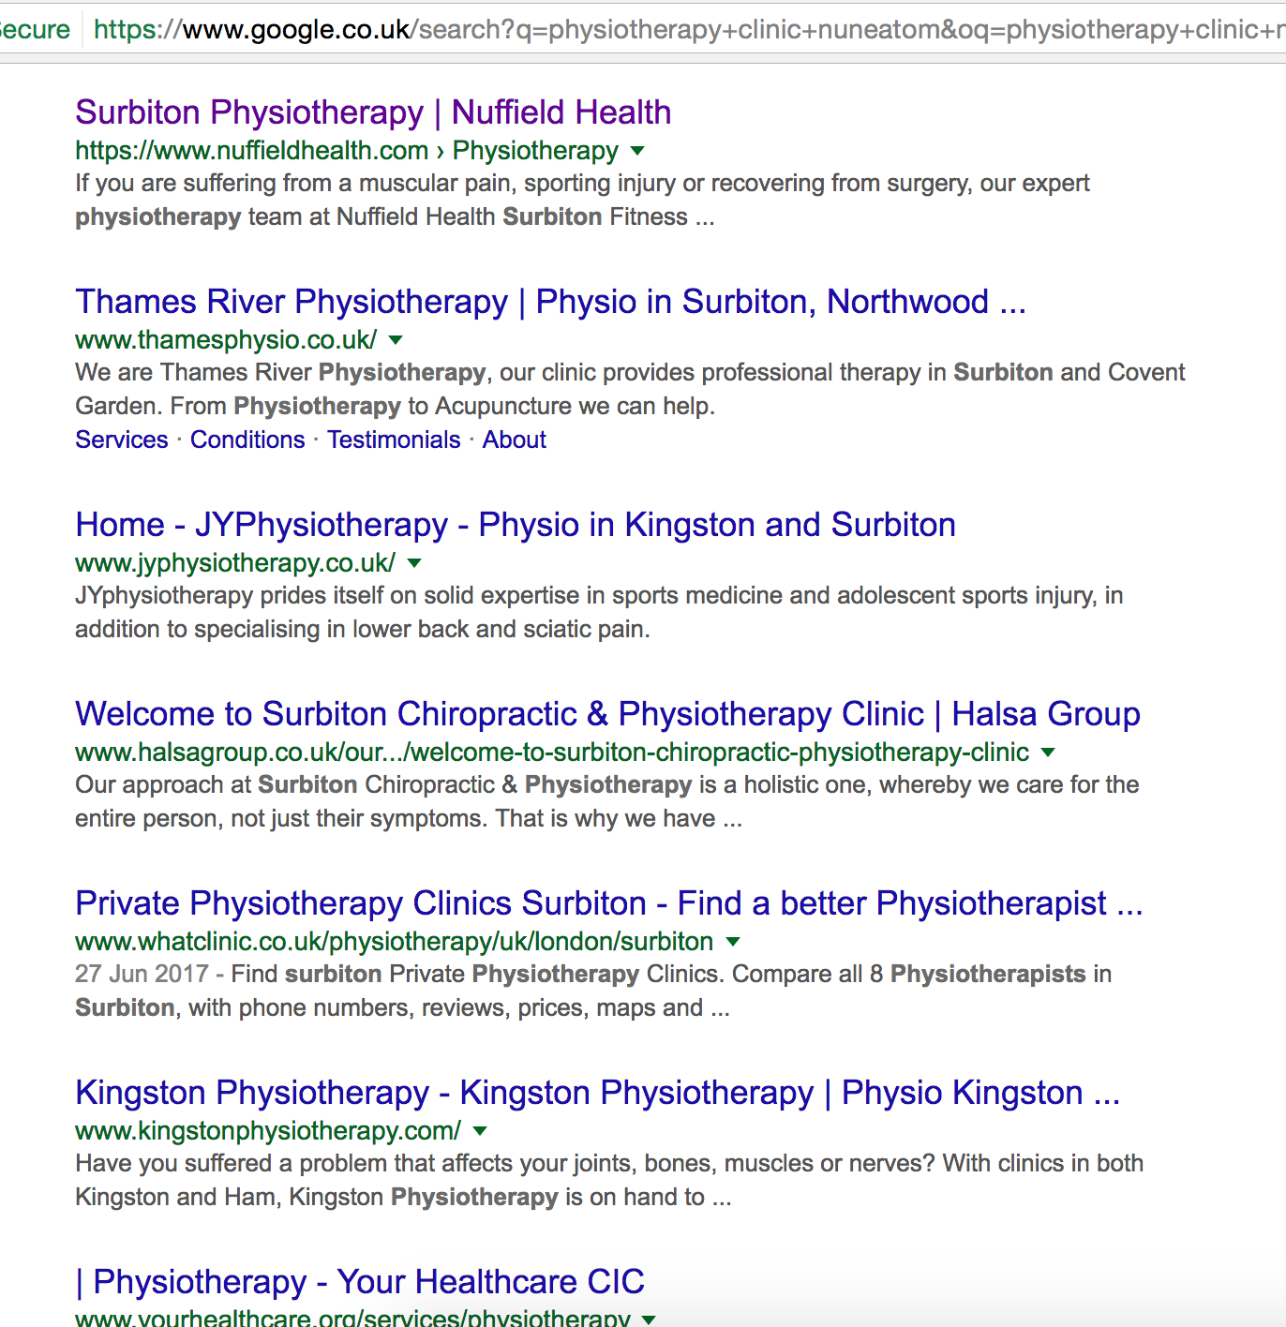
Improving your physiotherapy clinic’s
Search Engine Optimisation (SEO)

Slide 3
Why is Search Engine Optimisation (SEO) important for my clinic?
Search Engine Optimisation is a set of rules which when followed ensure that your web pages are attractive to search engines and achieve optimum search engine rankings.
Search Engine optimisation is essential because:
The majority of users are more likely to click on one of the top 5 suggestions in the results pages
SEO is not just about search engines; good SEO practices improve user experience and usability
Consumers trust search engines and having a presence in the top positions for the keywords the consumer is searching increases the web site’s trust

Slide 4
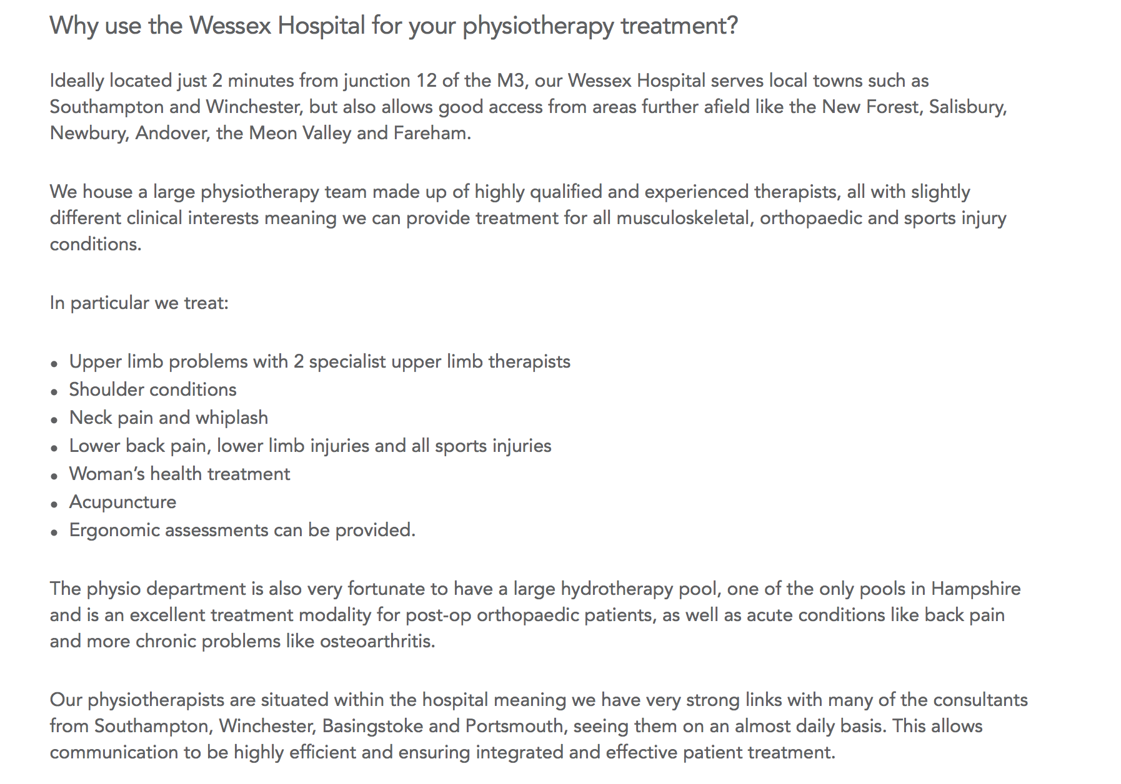
Google loves localised & unique content
Ensure that the opening paragraphs on your clinic pages are unique
Use the opening copy as an opportunity to describe the location of the clinic, using local landmarks and keywords
You could also introduce your physiotherapy team (e.g 6 physios, 2 senior physios which specialise in…)
List specific conditions you can treat and what treatments are provided (i.e. acupuncture)
Include information about any additional services you offer (i.e. clinical pilates, recovery plus, sports massage and hydrotherapy)

Slide 5
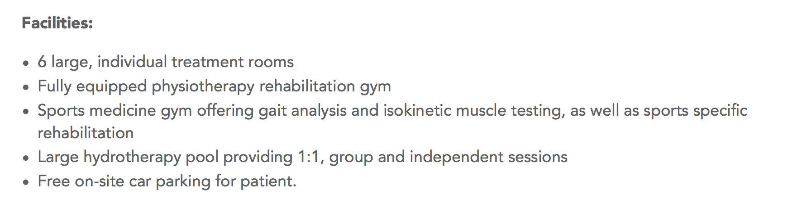
Highlight the Strengths of your Physiotherapy clinic facilities
Ensure your content stands out in Google, both from other Nuffield and external clinics, by describing your facilities. What makes you different from the competition?
Examples: Use of gym facilities - Free on-site parking - Hydrotherapy pool - Clinical Pilates programme

Slide 6
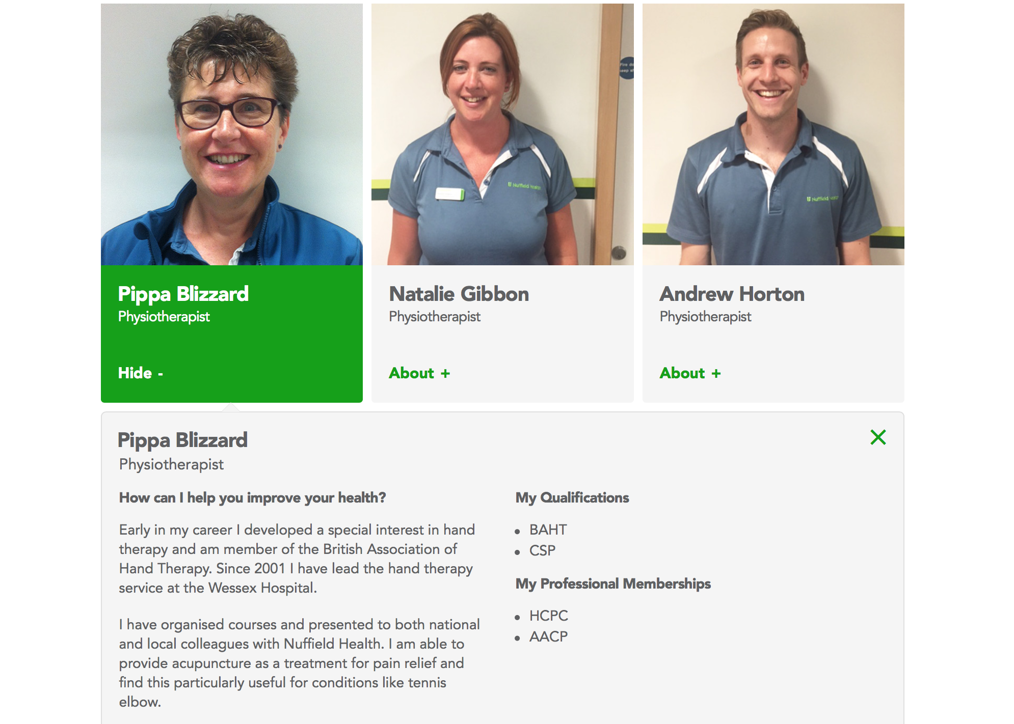
Use only high quality images & ensure descriptive bio content
Ensure your bio content is personalised and unique
Include relevant keywords in your copy (locations, qualifications, treatments, techniques, specialities)
Ensure your qualifications and memberships are up to date and that you own/manage your content
For the new physio profile image template, we require high resolution images to upload
Please ensure that your photo follows our guidelines:
- Please use a plain backdrop with appropriate lighting
- Wear Nuffield Health physiotherapy uniform
- Try and capture head and shoulders in image to remain consistent with other images
- Send the image in its original/largest file size to preserve quality
- You can take a decent profile picture with your mobile phone

Slide 7
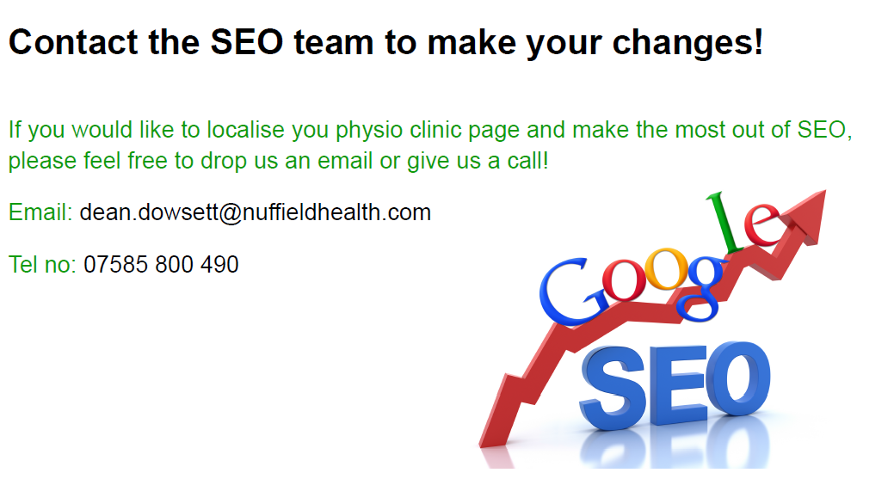

Slide 8
Best practice examples
Wessex - https://www.nuffieldhealth.com/physiotherapy/hampshire
Milton Keynes - https://www.nuffieldhealth.com/physiotherapy/milton-keynes
Bristol - https://www.nuffieldhealth.com/physiotherapy/bristol
Farnham - https://www.nuffieldhealth.com/physiotherapy/farnham
St Albans - https://www.nuffieldhealth.com/physiotherapy/st-albans
Bournemouth - https://www.nuffieldhealth.com/physiotherapy/bournemouth

